Slide 1



ML/DL for Everyone with
Lecture 6:
Logistic Regression
Sung Kim <hunkim+ml@gmail.com> HKUST
Code: https://github.com/hunkim/PyTorchZeroToAll
Slides: http://bit.ly/PyTorchZeroAll

Slide 2

Call for Comments
Please feel free to add comments directly on these slides.
Other slides: http://bit.ly/PyTorchZeroAll
Picture from http://www.tssablog.org/archives/3280

Slide 3
ML/DL for Everyone with
Lecture 6:
Logistic Regression
Sung Kim <hunkim+ml@gmail.com> HKUST
Code: https://github.com/hunkim/PyTorchZeroToAll
Slides: http://bit.ly/PyTorchZeroAll

Slide 4

Binary prediction (0 or 1) is very useful!
Spent N hours for study, pass or fail?
GPA and GRE scores for the HKUST PHD program, admit or not?
Soccer game against Japan, win or lose?
She/he looks good, propose or not?
…

Slide 5
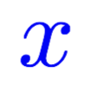
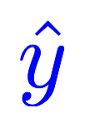
Linear model
Linear
Hours (x) | Points
1 | 2
2 | 4
3 | 6
4 | ?
Notes:
\hat{y}=x*w+b

Slide 6
Logistic regression: pass/fail (0 or 1)
Linear
Hours (x) | Points
1 | 2
2 | 4
3 | 6
4 | ?
fail/pass
0
0
1
?
Notes:
\hat{y}=x*w+b

Slide 7
Logistic regression: pass/fail (0 or 1)
Linear
Linear
Sigmoid
Hours (x) | Points
1 | 2
2 | 4
3 | 6
4 | ?
fail/pass
0
0
1
?
Notes:
\hat{y}=x*w+b

Slide 8
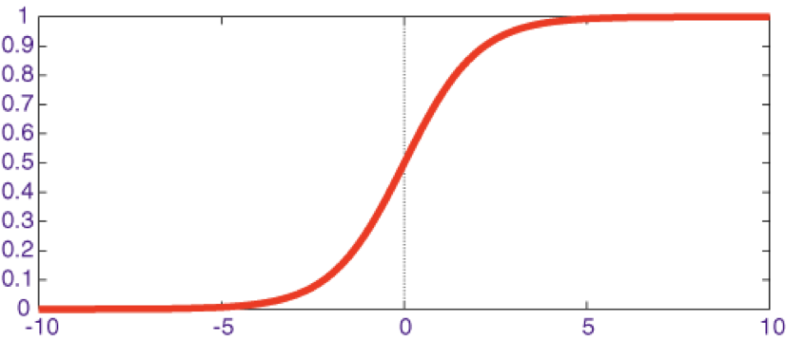

Meet sigmoid
Linear
Linear
Sigmoid
Hours (x) | Points
1 | 2
2 | 4
3 | 6
4 | ?
fail/pass
0
0
1
?
Notes:
\hat{y}=x*w+b

Slide 9


Meet sigmoid
Linear
Linear
Sigmoid
Hours (x) | Points
1 | 2
2 | 4
3 | 6
4 | ?
fail/pass
0
0
1
?
Notes:
\hat{y}=x*w+b
loss = \frac{1}{N}\sum_{n=1}^{N} y^{(n)} \log \hat{y}^{(n)} + (1 - y^{(n)}) \log (1-\hat{y}^{(n})

Slide 10
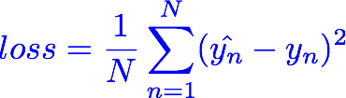
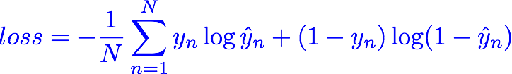
Meet Cross Entropy Loss
Linear
Linear
Sigmoid
Hours (x) | Points
1 | 2
2 | 4
3 | 6
4 | ?
fail/pass
0
0
1
?
Notes:
\hat{y}=x*w+b
loss = \frac{1}{N}\sum_{n=1}^{N} y^{(n)} \log \hat{y}^{(n)} + (1 - y^{(n)}) \log (1-\hat{y}^{(n})

Slide 11
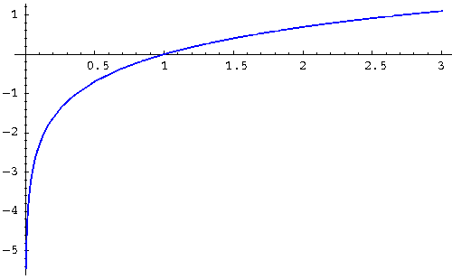
(Binary) Cross Entropy Loss
y | y_pred | loss
0 | 0.2
0 | 0.8
1 | 0.1
1 | 0.9
z
log(z)
Notes:
\hat{y}=x*w+b
loss = \frac{1}{N}\sum_{n=1}^{N} y^{(n)} \log \hat{y}^{(n)} + (1 - y^{(n)}) \log (1-\hat{y}^{(n})

Slide 12

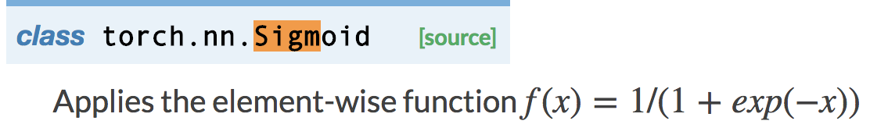
Logistic regression
Linear
Sigmoid
class Model(torch.nn.Module):
def __init__(self):
"""
In the constructor we instantiate two nn.Linear module
“""
super(Model, self).__init__()
self.linear = torch.nn.Linear(1, 1) # One in and one out
self.sigmoid = torch.nn.Sigmoid()
def forward(self, x):
"""
In the forward function we accept a Variable of input data and we must return
a Variable of output data. We can use Modules defined in the constructor as
well as arbitrary operators on Variables.
"""
y_pred = self.sigmoid(self.linear(x))
return y_pred
Notes:
\hat{y}=x*w+b
loss = \frac{1}{N}\sum_{n=1}^{N} y^{(n)} \log \hat{y}^{(n)} + (1 - y^{(n)}) \log (1-\hat{y}^{(n})

Slide 13
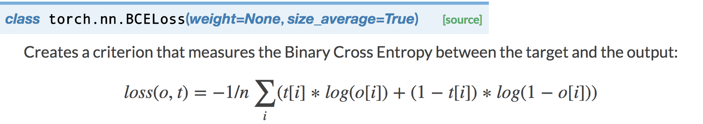
Logistic regression
Linear
Sigmoid
class Model(torch.nn.Module):
def __init__(self):
"""
In the constructor we instantiate two nn.Linear module
“""
super(Model, self).__init__()
self.linear = torch.nn.Linear(1, 1) # One in and one out
self.sigmoid = torch.nn.Sigmoid()
def forward(self, x):
"""
In the forward function we accept a Variable of input data and we must return
a Variable of output data. We can use Modules defined in the constructor as
well as arbitrary operators on Variables.
"""
y_pred = self.sigmoid(self.linear(x))
return y_pred
criterion = torch.nn.BCELoss(size_average=True)
Notes:
\hat{y}=x*w+b
loss = \frac{1}{N}\sum_{n=1}^{N} y^{(n)} \log \hat{y}^{(n)} + (1 - y^{(n)}) \log (1-\hat{y}^{(n})

Slide 14
Logistic regression
x_data = Variable(torch.Tensor([[1.0], [2.0], [3.0], [4.0]]))
y_data = Variable(torch.Tensor([[0.], [0.], [1.], [1.]]))
class Model(torch.nn.Module):
def __init__(self):
"""
In the constructor we instantiate two nn.Linear module
"""
super(Model, self).__init__()
self.linear = torch.nn.Linear(1, 1) # One in and one out
self.sigmoid = torch.nn.Sigmoid()
def forward(self, x):
"""
In the forward function we accept a Variable of input data and we must return
a Variable of output data. We can use Modules defined in the constructor as
well as arbitrary operators on Variables.
"""
y_pred = self.sigmoid(self.linear(x))
return y_pred
# our model
model = Model()
# Construct our loss function and an Optimizer. The call to model.parameters()
# in the SGD constructor will contain the learnable parameters of the two
# nn.Linear modules which are members of the model.
criterion = torch.nn.BCELoss(size_average=True)
optimizer = torch.optim.SGD(model.parameters(), lr=0.01)
# Training loop
for epoch in range(500):
# Forward pass: Compute predicted y by passing x to the model
y_pred = model(x_data)
# Compute and print loss
loss = criterion(y_pred, y_data)
print(epoch, loss.data[0])
# Zero gradients, perform a backward pass, and update the weights.
optimizer.zero_grad()
loss.backward()
optimizer.step()
# After training
hour_var = Variable(torch.Tensor([[0.5]]))
print("predict (after training)", 0.5, model.forward(hour_var).data[0][0])
hour_var = Variable(torch.Tensor([[7.0]]))
print("predict (after training)", 7.0, model.forward(hour_var).data[0][0])
Notes:
\hat{y}=x*w+b
loss = \frac{1}{N}\sum_{n=1}^{N} y^{(n)} \log \hat{y}^{(n)} + (1 - y^{(n)}) \log (1-\hat{y}^{(n})

Slide 15

Logistic regression
x_data = Variable(torch.Tensor([[1.0], [2.0], [3.0], [4.0]]))
y_data = Variable(torch.Tensor([[0.], [0.], [1.], [1.]]))
class Model(torch.nn.Module):
def __init__(self):
"""
In the constructor we instantiate two nn.Linear module
"""
super(Model, self).__init__()
self.linear = torch.nn.Linear(1, 1) # One in and one out
self.sigmoid = torch.nn.Sigmoid()
def forward(self, x):
"""
In the forward function we accept a Variable of input data and we must return
a Variable of output data. We can use Modules defined in the constructor as
well as arbitrary operators on Variables.
"""
y_pred = self.sigmoid(self.linear(x))
return y_pred
# our model
model = Model()
# Construct our loss function and an Optimizer. The call to model.parameters()
# in the SGD constructor will contain the learnable parameters of the two
# nn.Linear modules which are members of the model.
criterion = torch.nn.BCELoss(size_average=True)
optimizer = torch.optim.SGD(model.parameters(), lr=0.01)
# Training loop
for epoch in range(500):
# Forward pass: Compute predicted y by passing x to the model
y_pred = model(x_data)
# Compute and print loss
loss = criterion(y_pred, y_data)
print(epoch, loss.data[0])
# Zero gradients, perform a backward pass, and update the weights.
optimizer.zero_grad()
loss.backward()
optimizer.step()
# After training
hour_var = Variable(torch.Tensor([[0.5]]))
print("predict (after training)", 0.5, model.forward(hour_var).data[0][0])
hour_var = Variable(torch.Tensor([[7.0]]))
print("predict (after training)", 7.0, model.forward(hour_var).data[0][0])
Design your model using class
Linear
Sigmoid
Notes:
\hat{y}=x*w+b
loss = \frac{1}{N}\sum_{n=1}^{N} y^{(n)} \log \hat{y}^{(n)} + (1 - y^{(n)}) \log (1-\hat{y}^{(n})

Slide 16


Logistic regression
x_data = Variable(torch.Tensor([[1.0], [2.0], [3.0], [4.0]]))
y_data = Variable(torch.Tensor([[0.], [0.], [1.], [1.]]))
class Model(torch.nn.Module):
def __init__(self):
"""
In the constructor we instantiate two nn.Linear module
"""
super(Model, self).__init__()
self.linear = torch.nn.Linear(1, 1) # One in and one out
self.sigmoid = torch.nn.Sigmoid()
def forward(self, x):
"""
In the forward function we accept a Variable of input data and we must return
a Variable of output data. We can use Modules defined in the constructor as
well as arbitrary operators on Variables.
"""
y_pred = self.sigmoid(self.linear(x))
return y_pred
# our model
model = Model()
# Construct our loss function and an Optimizer. The call to model.parameters()
# in the SGD constructor will contain the learnable parameters of the two
# nn.Linear modules which are members of the model.
criterion = torch.nn.BCELoss(size_average=True)
optimizer = torch.optim.SGD(model.parameters(), lr=0.01)
# Training loop
for epoch in range(500):
# Forward pass: Compute predicted y by passing x to the model
y_pred = model(x_data)
# Compute and print loss
loss = criterion(y_pred, y_data)
print(epoch, loss.data[0])
# Zero gradients, perform a backward pass, and update the weights.
optimizer.zero_grad()
loss.backward()
optimizer.step()
# After training
hour_var = Variable(torch.Tensor([[0.5]]))
print("predict (after training)", 0.5, model.forward(hour_var).data[0][0])
hour_var = Variable(torch.Tensor([[7.0]]))
print("predict (after training)", 7.0, model.forward(hour_var).data[0][0])
Design your model using class
Linear
Sigmoid
Construct loss and optimizer
(select from PyTorch API)
Training cycle
(forward, backward, update)
Notes:
\hat{y}=x*w+b
loss = \frac{1}{N}\sum_{n=1}^{N} y^{(n)} \log \hat{y}^{(n)} + (1 - y^{(n)}) \log (1-\hat{y}^{(n})

Slide 17
Logistic regression
x_data = Variable(torch.Tensor([[1.0], [2.0], [3.0], [4.0]]))
y_data = Variable(torch.Tensor([[0.], [0.], [1.], [1.]]))
class Model(torch.nn.Module):
def __init__(self):
"""
In the constructor we instantiate two nn.Linear module
"""
super(Model, self).__init__()
self.linear = torch.nn.Linear(1, 1) # One in and one out
self.sigmoid = torch.nn.Sigmoid()
def forward(self, x):
"""
In the forward function we accept a Variable of input data and we must return
a Variable of output data. We can use Modules defined in the constructor as
well as arbitrary operators on Variables.
"""
y_pred = self.sigmoid(self.linear(x))
return y_pred
# our model
model = Model()
# Construct our loss function and an Optimizer. The call to model.parameters()
# in the SGD constructor will contain the learnable parameters of the two
# nn.Linear modules which are members of the model.
criterion = torch.nn.BCELoss(size_average=True)
optimizer = torch.optim.SGD(model.parameters(), lr=0.01)
# Training loop
for epoch in range(500):
# Forward pass: Compute predicted y by passing x to the model
y_pred = model(x_data)
# Compute and print loss
loss = criterion(y_pred, y_data)
print(epoch, loss.data[0])
# Zero gradients, perform a backward pass, and update the weights.
optimizer.zero_grad()
loss.backward()
optimizer.step()
# After training
hour_var = Variable(torch.Tensor([[0.5]]))
print("predict (after training)", 0.5, model.forward(hour_var).data[0][0])
hour_var = Variable(torch.Tensor([[7.0]]))
print("predict (after training)", 7.0, model.forward(hour_var).data[0][0])
0 1.6369143724441528
1 1.6119738817214966
2 1.5872894525527954
3 1.5628681182861328
4 1.5387169122695923
5 1.514843225479126
6 1.4912540912628174
7 1.467956781387329
8 1.4449583292007446
9 1.4222657680511475
10 1.3998862504959106
...
…
484 0.5245369672775269
485 0.5243527293205261
486 0.5241686701774597
487 0.5239847302436829
488 0.5238009095191956
489 0.5236172080039978
490 0.5234336256980896
491 0.523250162601471
492 0.5230668187141418
493 0.5228836536407471
494 0.5227005481719971
495 0.5225176215171814
496 0.5223348140716553
497 0.5221521258354187
498 0.5219695568084717
499 0.5217871069908142
predict (after training) 0.5 0.3970
predict (after training) 7.0 0.9398
Process finished with exit code 0
Notes:
\hat{y}=x*w+b
loss = \frac{1}{N}\sum_{n=1}^{N} y^{(n)} \log \hat{y}^{(n)} + (1 - y^{(n)}) \log (1-\hat{y}^{(n})

Slide 18


Lecture 7:
Wide and Deep

